Slide 1

Fundamental Of Structured Programming Lecture 5 Char, String
Dr. Ahmed Yousry
Lecturer, Computer Science Department,
Faculty of computers and artificial intelligence, benha university

Slide 2
Working with Characters and Strings
char: holds a single character
string: holds a sequence of characters
Both can be used in assignment statements
Both can be displayed with cout and <<

Slide 3
String Operators
= Assigns a value to a string
string words;
words = "Tasty ";
+ Joins two strings together
string s1 = "hot", s2 = "dog";
string food = s1 + s2; // food = "hotdog"
+= Concatenates a string onto the end of another one
words += food; // words now = "Tasty hotdog"

Slide 4
string Member Functions
length() – the number of characters in a string
string firstPrez="George Washington";
int size=firstPrez.length();
// size is 17
Another Example:
string state = "Texas"; int size = state.length();
// size is 5
Notes:
See pr3-25.cpp

Slide 5



assign ()
assign() – put repeated characters in a string. Can be used for formatting output.
string equals;
equals.assign(80,'=');
cout << equals << endl;
string str;
str.assign(10, '*'); // Assigns 10 asterisks to the string
cout << str << endl;
string str1 = "Hello, World!";
string str2; str2.assign(str1, 0, 5); // Assigns the first 5 characters of str1 to str2
cout << str2 << endl;
string str1 = "Learning C++";
string str2; str2.assign(str1); // Assigns the entire string str1 to str2
cout << str2 << endl;

Slide 6
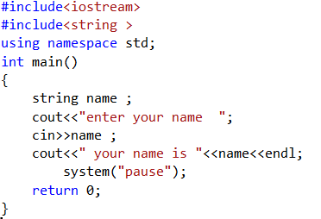

String Input
Reading in a string object
string name;
cin >> name; // Reads in a string with no blanks
Using cin with the >> operator to input strings can cause problems:
It passes over and ignores any leading whitespace characters (spaces, tabs, or line breaks)
Notes:
See pr3-21.cpp and pr3-22.cpp

Slide 7
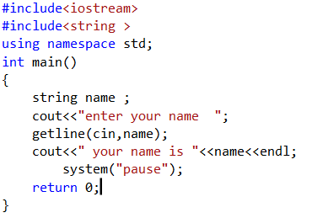

Input string
To solve this problem, you can use a C++ function named getline.
getline(cin, name ); // Reads in a string
// that may contain
// blanks

Slide 8
Character Input
Reading in a character:
char ch;
cin >> ch; // Reads in any non-blank char
Problem: will skip over blanks, tabs
cin.get(ch); // Reads in any char
Will read the next character entered, even whitespace
ch = cin.get;// Reads in any char
Notes:
See pr3-23.cpp and pr3-24.cpp

Slide 9
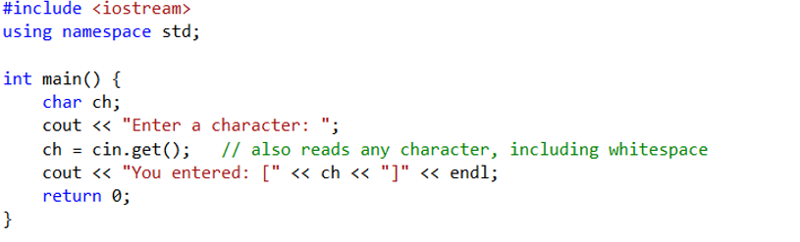
Example

Slide 10
Working with Characters and string Objects
Mixing cin >> and cin.get() in the same program can cause input errors that are hard to detect.
To skip over unneeded characters that are still in the keyboard buffer, use cin.ignore():
cin.ignore(); // skip next char
cin.ignore(10, '\n'); // skip the next
// 10 char. or until a '\n'

Slide 11
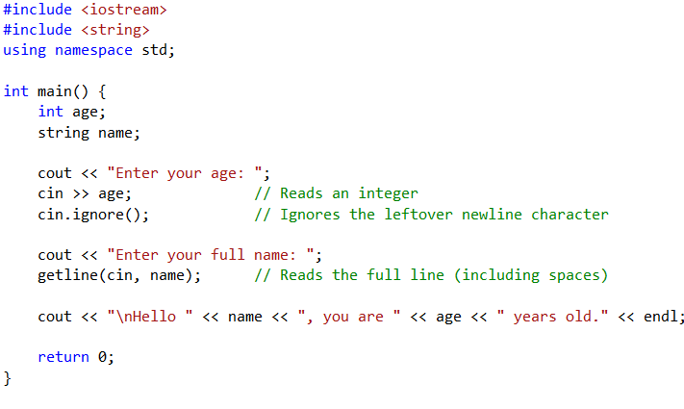
Example

Slide 12
Fundamental Of Structured Programming Lecture 5 Making Decisions Chapeter 4 in book
Dr. Ahmed Yousry
Lecturer, Computer Science Department,
Faculty of computers and artificial intelligence, benha university

Slide 13
Making Decisions
Decision Making Statements
If- statement
If-else statement
Switch statement
Conditional Operator

Slide 14
Relational Operators
Used to compare numeric values to determine relative order
Operators:
> | Greater than
< | Less than
>= | Greater than or equal to
<= | Less than or equal to
== | Equal to
!= | Not equal to

Slide 15
Relational Expressions
Relational expressions are Boolean (i.e., evaluate to true or false)
Examples:
12 > 5 is true
7 <= 5 is false
if x is 10, then
x == 10 is true ,
x <= 8 is false,
x != 8 is true
X > 8 is true , and
x == 8 is false
Can be assigned to a variable
bool result = (x <= y);
Assigns 0 for false, 1 for true.
Note:
Do not confuse = (assignment) and == (equal to).

Slide 16
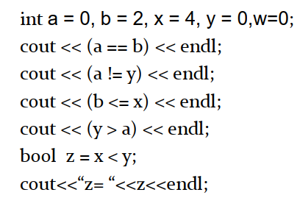
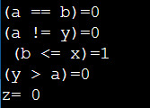
Example
What is the output of this program?

Slide 17
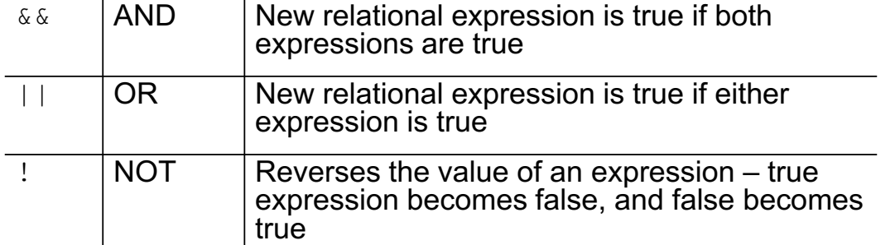
Logical Operators
Used to create relational expressions from other relational expressions
Operators, meaning, and explanation:

Slide 18
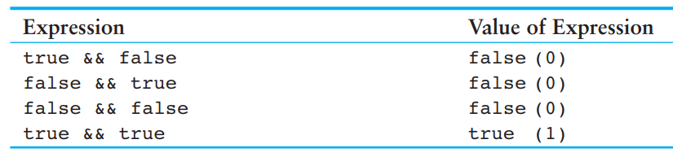
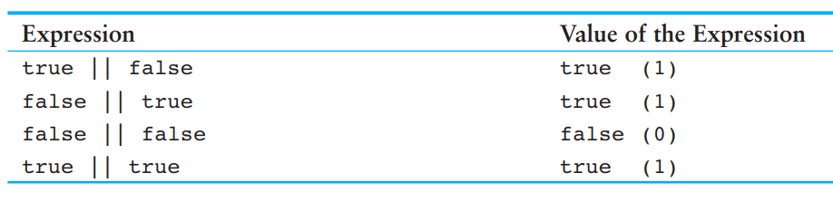
Logical Operators
&&
||

Slide 19
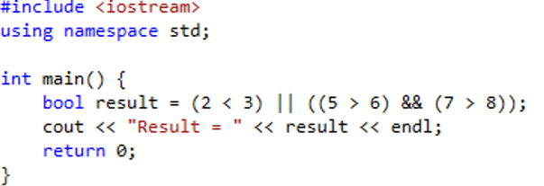

Logical precedence
Highest !
&&
Lowest ||
Example :

Slide 20
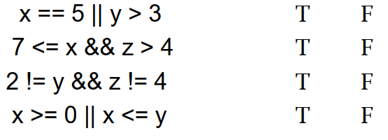
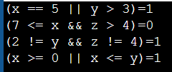
Example
What is the output of this program?
Assume the variables x = 5 , y = 6 , and z = 8 .

Slide 21
Example
int number1=10;
int number2 = 15;
1. (number1 > number2) || (number1 == 10) (T)
2. (number1 > number2) && (number1 == 10) (F)
3. (number1 != number2) && (number1 == 10) (T)
4. !(number1 == number2) (T)

Slide 22
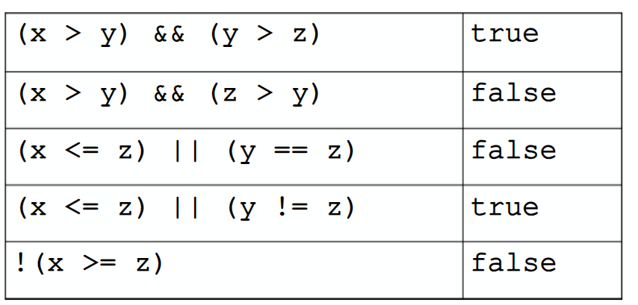
Example
int x=12 ,y = 5 ,z = -4;

Slide 23
Making Decisions if-statement

Slide 24
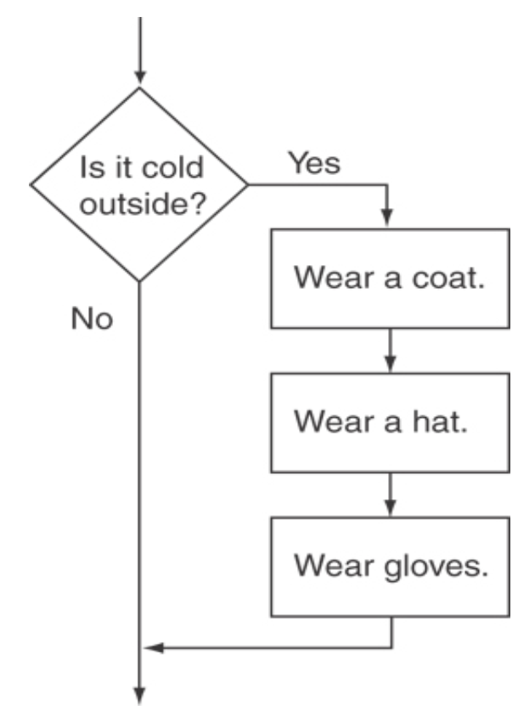
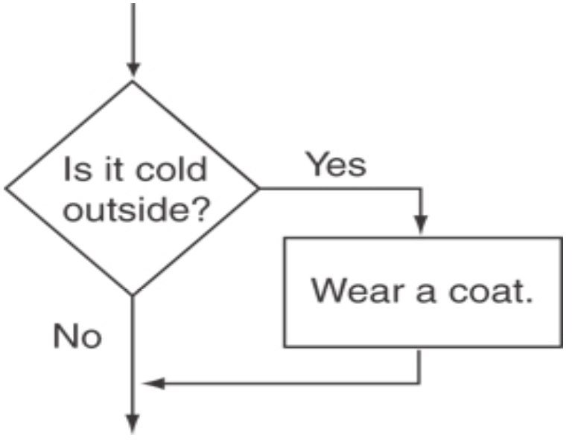
The if Statement
Supports the use of a decision structure
Allows statements to be conditionally executed or skipped over
Models the way we mentally evaluate situations
“If it is cold outside,
wear a coat.”
"If it is raining,
take an umbrella.“
“If it is cold outside,
wear a coat and wear a hat
and wear gloves .”

Slide 25
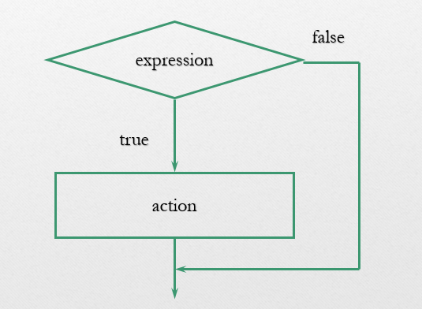
The if Statement
General Format:
if the expression is true then execute the action.
action is either a single statement or a group of statements in this case must set within braces {}.
if (expression) action;
if (expression)
}
statement_1;
statement_2;
:
statement_n;
{

Slide 26
Format of the if Statement
if (condition)
statement1;
or
{
statement2;
…
statementn;
}
The block inside the braces is called the body of the if statement.
If there is only 1 statement in the body, the { } may be omitted.
Notes:
See pr4-02.cpp

Slide 27
How the if Statement Works
To evaluate:
if (expression)
statement;
If (expression) is true, then the statement(s) in the body are executed.
If (expression) is false, then the statement(s) are skipped.

Slide 28
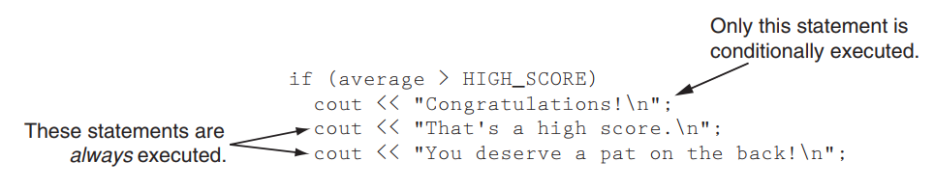
if Statement Notes
if is a keyword. It must be lowercase
(condition)must be in ( )
Do not place ; after (condition)
Don't forget the { } around a multi-statement body.

Slide 29
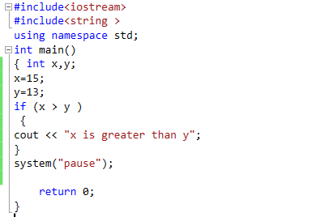

Example

Slide 30
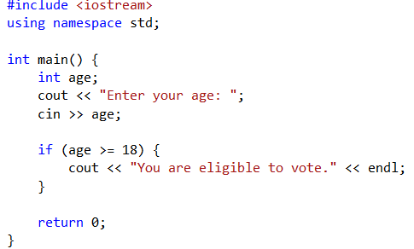

Example

Slide 31

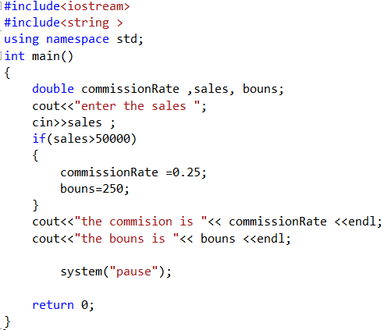

Example

Slide 32
The if/else Statement
Provides two possible paths of execution
Allows a choice between statements depending on whether (condition) is true or false
Performs one statement or block if the expression is true, otherwise performs another statement or block.
Format:
if (condition)
{
statement set 1;
}
else
{
statement set 2;
}

Slide 33
How the if/else Works
To evaluate:
if (expression)
statement1;
else
statement2;
If (condition) is true, statement1 is executed and statement 2 is skipped.
If (condition) is false, statement1 is skipped and statement 2 is executed.
Notes:
See pr4-03.cpp

Slide 34
if/else Flow of Control
true
false
condition
statement1
statement2

Slide 35
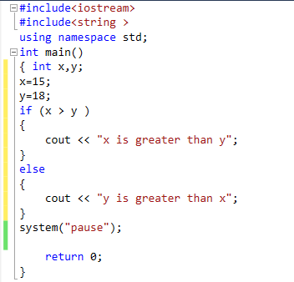
Example

Slide 36
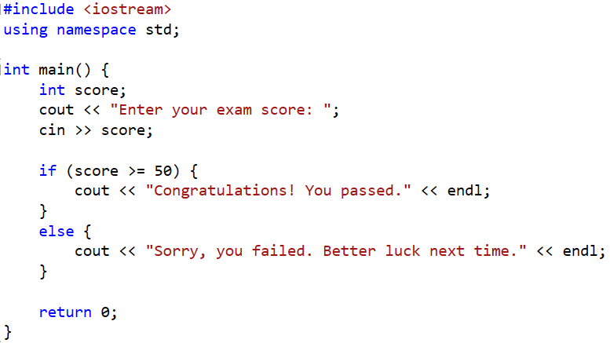
Example

Slide 37
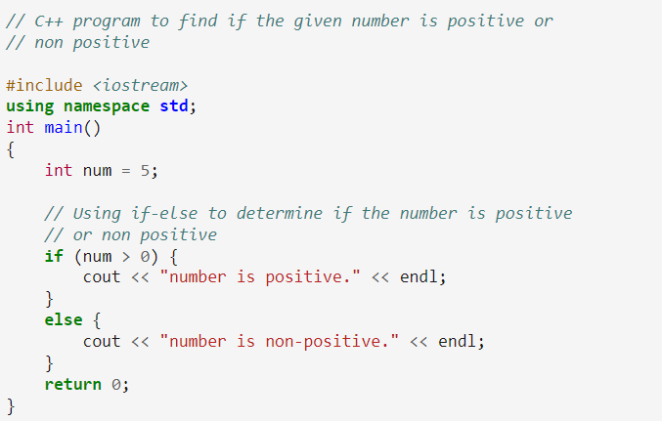

Example

Slide 38
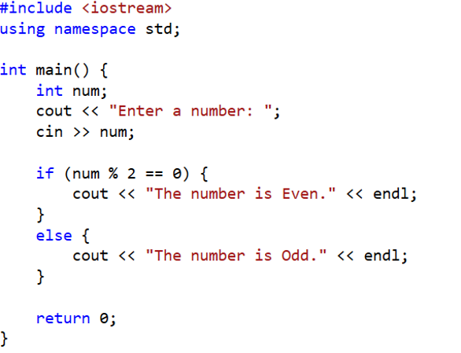
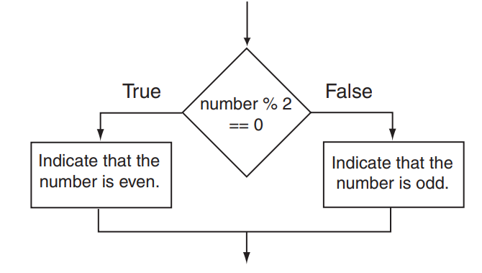
Exercise: check if the number is even or odd

Slide 39
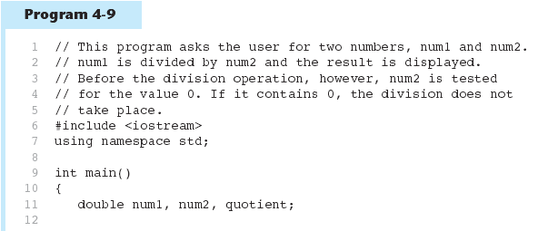
Testing the Divisor in Program 4-9
Continued…

Slide 40
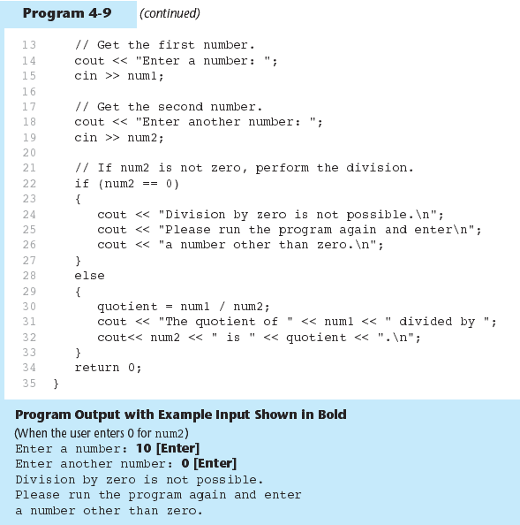
Testing the Divisor in Program 4-9

Slide 41
Example
Write an if/else statement that assigns 0.10 to commissionRate unless sales is greater than or equal to 50000.00, in which case it assigns 0.20 to commissionRate
if (sales >= 50000.00) {
commissionRate = 0.20;
} else {
commissionRate = 0.10;
}
Write an if/else statement that assigns 1 to x if y is equal to 100. Otherwise, it should assign 0 to x. int x;
int y = 100; // Example value for y
if (y == 100) {
x = 1;
} else {
x = 0;
}

Slide 42
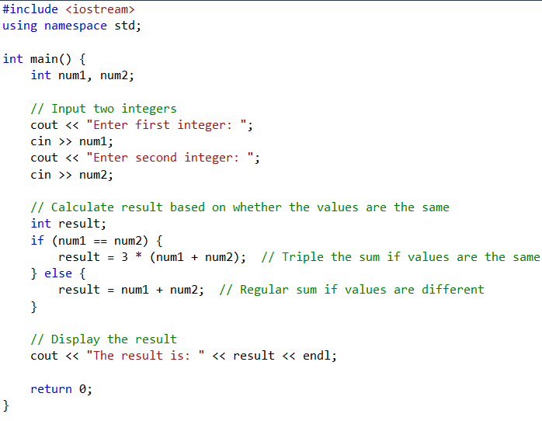
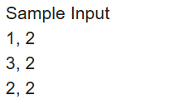
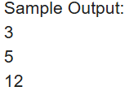
Example
Write a C++ program to compute the sum of two given integer values. If the two values are the same, then return triple their sum

Slide 43
Nested if Statements
An if statement that is nested inside another if statement
Nested if statements can be used to test more than one condition

Slide 44
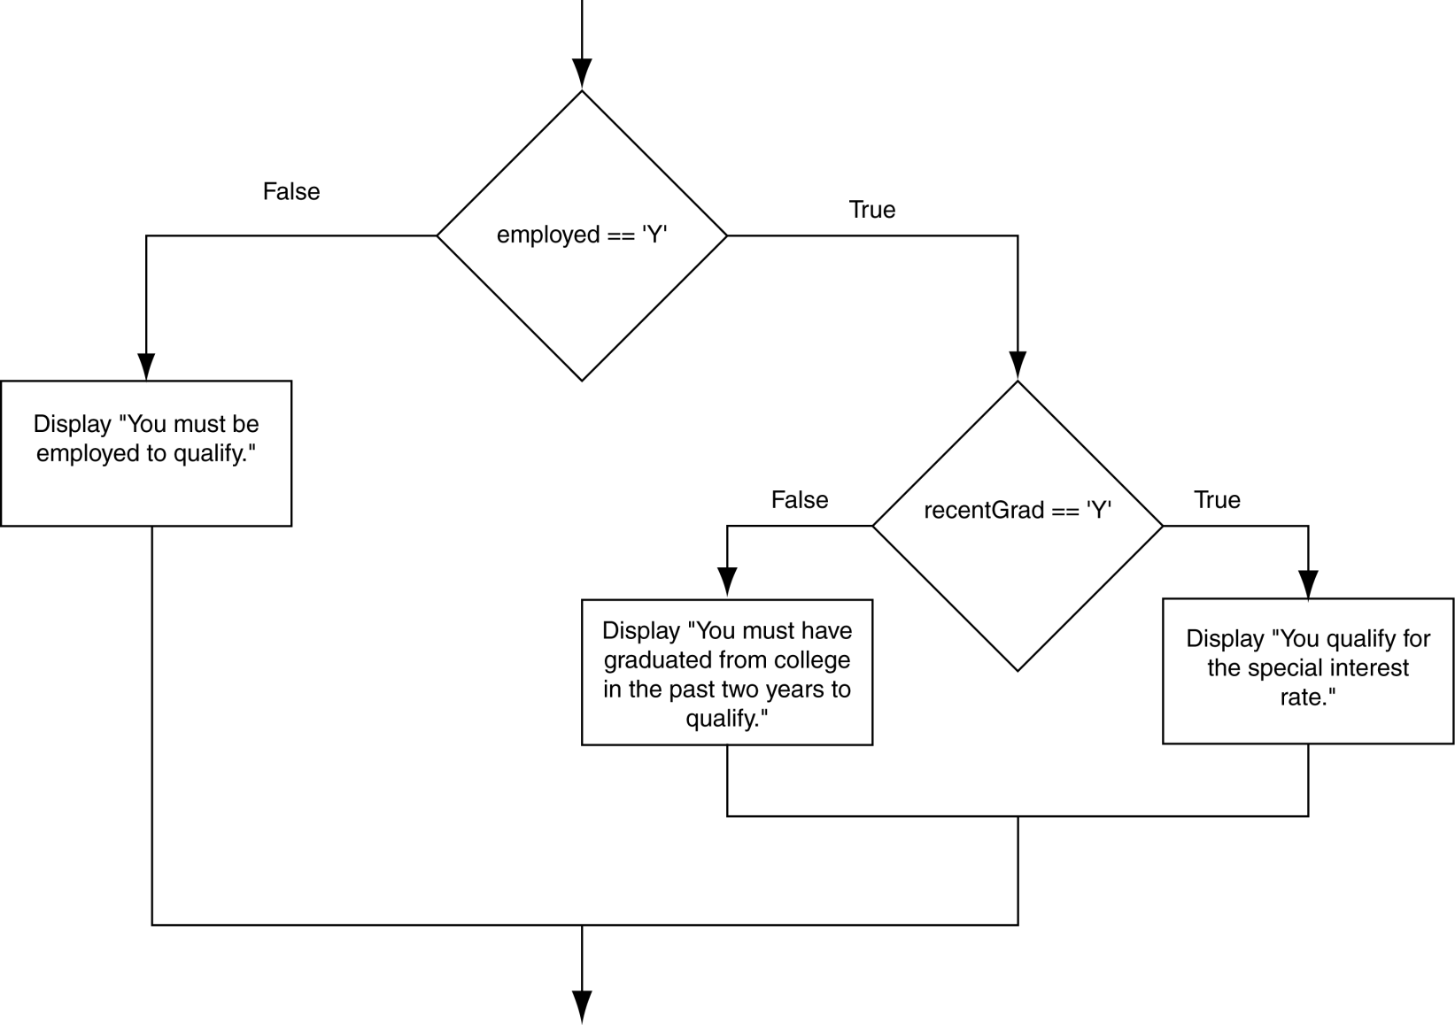
Flowchart for a Nested if Statement

Slide 45
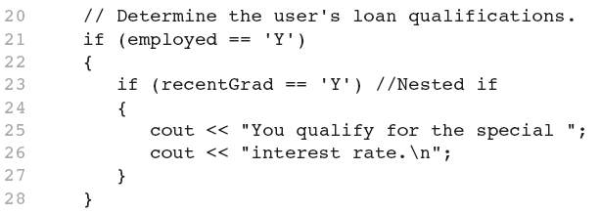
Nested if Statements

Slide 46
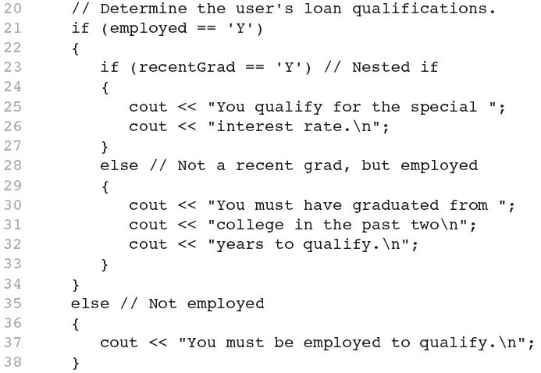
Nested if Statements
Another example, from Program 4-1

Slide 47
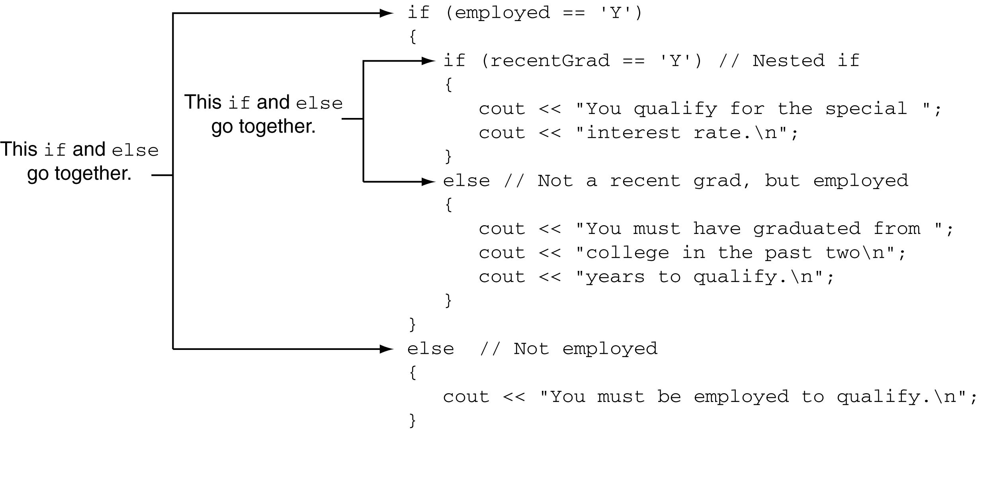
Use Proper Indentation!

Slide 48
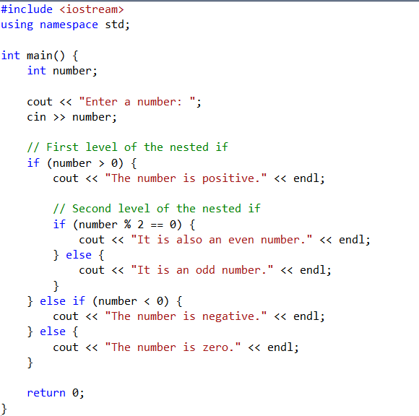
Nested if statement

Slide 49
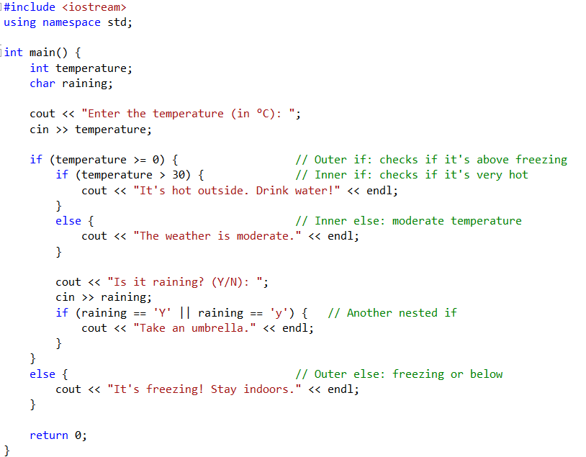

Example

Slide 50
The if/else if Statement
Tests a series of conditions until one is found to be true
Often simpler than using nested if/else statements
Can be used to model thought processes such as: "If it is raining, take an umbrella, else, if it is windy, take a hat, else, take sunglasses”

Slide 51
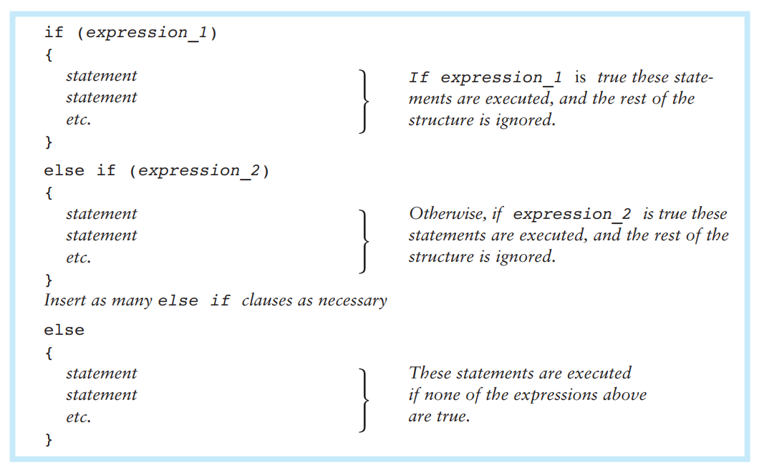
The if/else if Statement

Slide 52
Using a Trailing else
else Used with if/else if statement when all of the conditions are false
Provides a default statement or action that is performed when none of the conditions is true
Can be used to catch invalid values or handle other exceptional situations

Slide 53
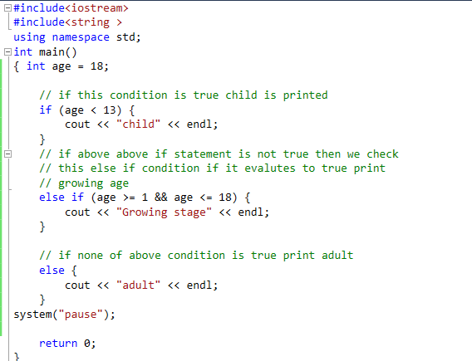

Example
// C++ program to find if the person is child, growing age
// or adult using if else-if ladder

Slide 54
Example if/else if with Trailing else
if (age >= 21)
cout << "Adult";
else if (age >= 13)
cout << "Teen";
else if (age >= 2)
cout << "Child";
else
cout << "Baby";
Notes:
See pr4-09.cpp

Slide 55
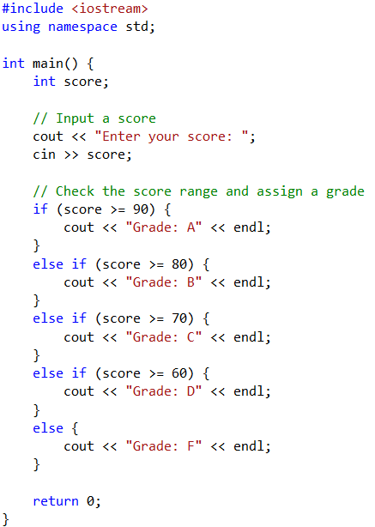
Example
Write a C++ program that prompts the user to enter their score and then assigns a grade based on the following criteria:
If the score is 90 or above, the grade is "A".
If the score is between 80 and 89, the grade is "B".
If the score is between 70 and 79, the grade is "C".
If the score is between 60 and 69, the grade is "D".
If the score is below 60, the grade is "F".

Slide 56
Exercise
Write a C++ program to find maximum between three numbers.
#include<iostream>
using namespace std;
int main()
{
float n1, n2, n3;
cout << "Enter three numbers: ";
cin >> n1 >> n2 >> n3;
if(n1 >= n2 && n1 >= n3)
{
cout << "Largest number: " << n1<<endl;}
else if(n2 >= n1 && n2 >= n3)
{
cout << "Largest number: " << n2<<endl;}
else //else hear means : if(n3 >= n1 && n3 >= n2)
{
cout << "Largest number: " << n3<<endl; }
system("pause");
return 0; }

Slide 57
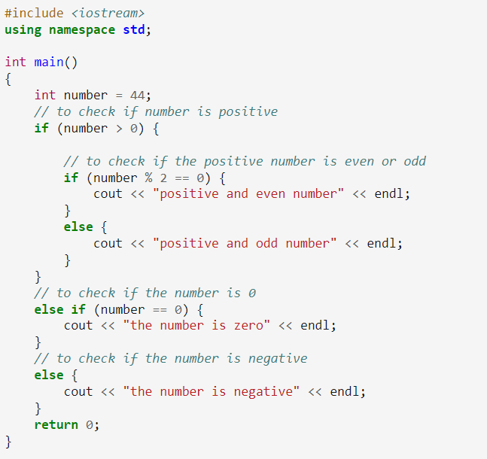

Example
// C++ program to check if the given number is positive, negative or zero if //positive then check if it is even or odd

Slide 58
Menu-Driven Program
Menu: list of choices presented to the user on the computer screen.
Menu-driven program: program execution controlled by user selecting from a list of actions.
Menu can be implemented using if/ else if statements.

Slide 59
Menu-driven Program Organization
Display list of numbered or lettered choices for actions.
Input user’s selection of number or letter
Test user selection in (condition)
if a match, then execute code to carry out the desired action
if not, then test with next (condition)
Notes:
See pr4-10.cpp

Slide 60
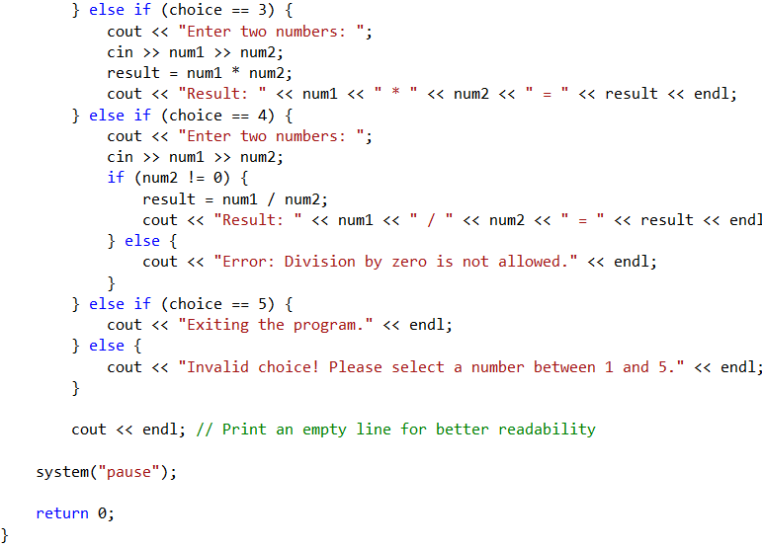
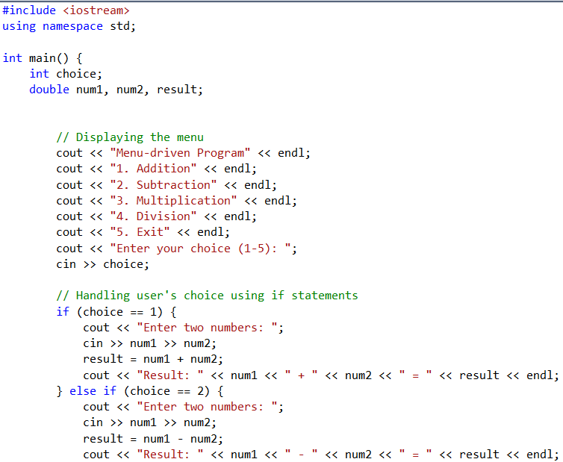
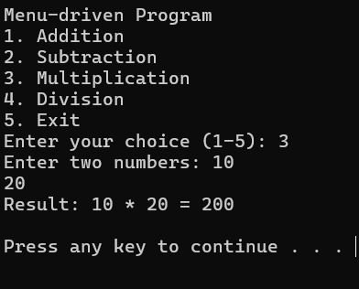
Example

Slide 61
Thank you

